Slide 1



Patterns in Data Mining: An Introduction
A pattern is a regularity, relationship, trend, or structure found within data. It transforms raw data into meaningful knowledge.
A pattern is a representation of knowledge discovered from large datasets that reveals frequent occurrences, correlations, deviations, or structures useful for decision-making.
Think of it as finding gold nuggets in a river of sand.
Notes:
1

Slide 2




Characteristics & Importance of Patterns
Novel & Useful
Valid & Understandable
Not already known, supports decisions & predictions.
Works on new data, human-interpretable.
Unexpected
Reveals hidden insights.
Why Patterns Matter?
Data is too vast for manual analysis. Patterns reveal hidden knowledge, crucial for business decisions, fraud detection, and optimisation.
Notes:
2

Slide 3
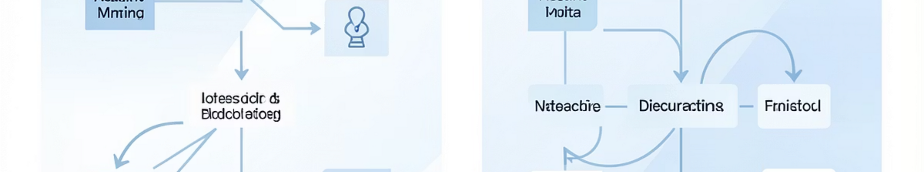
Classification of Data Mining Patterns
1
2
Descriptive
Predictive
Summarises and describes data. Answers: "What is happening?"
Predicts future values. Answers: "What will happen?"
Descriptive techniques include Clustering, Association, and Outlier Detection. Predictive techniques involve Classification and Prediction (Regression).
Notes:
3

Slide 4

Classification Patterns
1. Classification
Predicts categorical class labels (e.g., Yes/No). It is predictive and supervised, using labelled training data.
Algorithms: Decision Trees, Naive Bayes, SVM, KNN.
Example: Predicting customer churn.
Application: Telecom companies predict customer switching.
Notes:
4

Slide 5
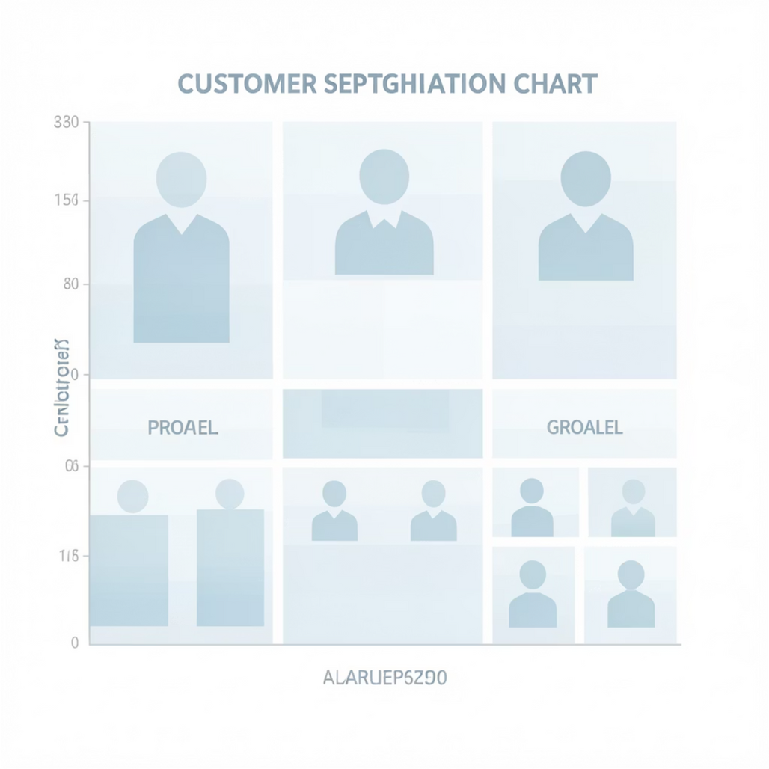
Clustering Patterns
2. Clustering
Groups similar data objects without predefined labels. It is descriptive and unsupervised.
Algorithms: K-Means, Hierarchical, DBSCAN.
Example: Customer segmentation (high vs. low spenders).
Application: E-commerce personalised marketing.
Notes:
5

Slide 6
Association Rules
3. Association Rules
Identifies items that frequently occur together. This is a descriptive and unsupervised method, using Support & Confidence metrics.
Algorithm: Apriori.
Example: Buying cola often leads to buying chips.
Application: Supermarket product placement.
Notes:
6

Slide 7
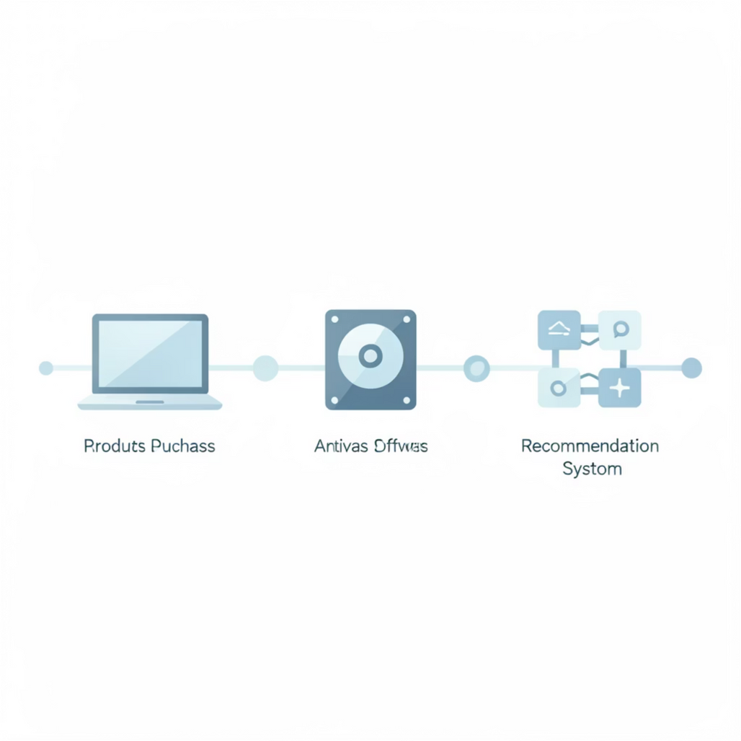
Sequential Patterns
4. Sequential Patterns
Discovers ordered events over time, considering sequence and timing.
Example: Laptop → Hard Disk → Antivirus.
Application: Next-product recommendation systems.
Notes:
7

Slide 8

Outlier Detection
5. Outlier / Anomaly Detection
Identifies rare or abnormal data points, primarily unsupervised.
Algorithms: Statistical, Distance-based.
Example: An unusual £5 lakh foreign transaction.
Application: Credit card fraud detection.
Notes:
8

Slide 9
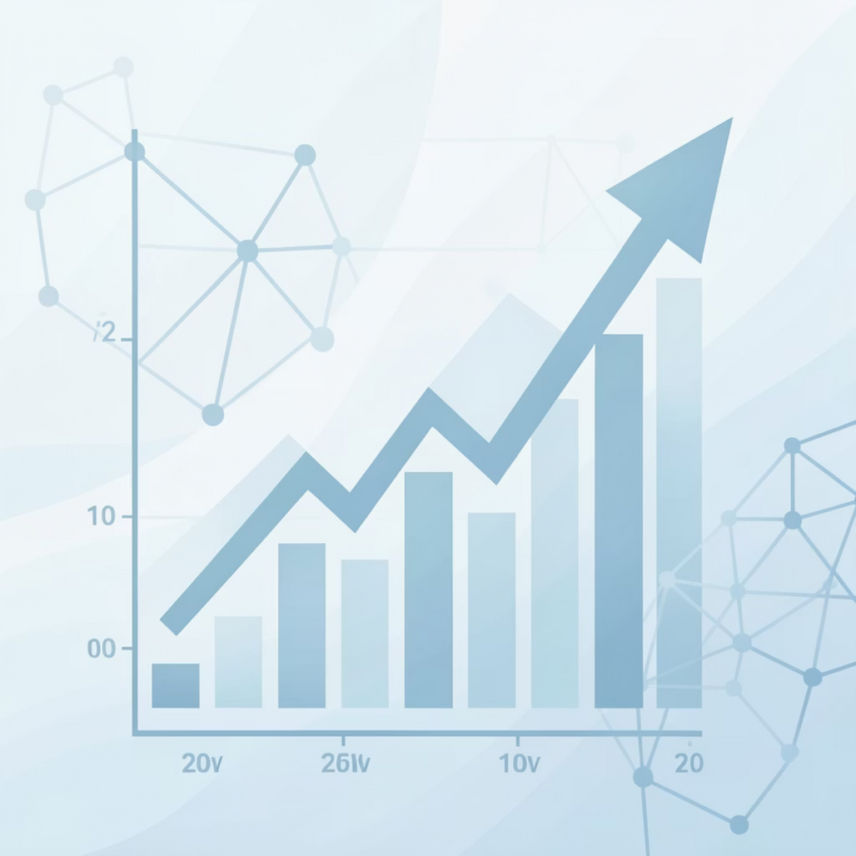
Prediction (Regression)
6. Prediction (Regression)
Predicts continuous numeric values. This is a predictive and supervised method.
Algorithms: Linear Regression, Neural Networks.
Example: Stock price or sales forecasting.
Notes:
9

Slide 10
Quick Revision
Classification
Supervised, predicts class (e.g., customer churn).
Clustering
Unsupervised, groups data (e.g., customer segmentation).
Association
Unsupervised, finds relations (e.g., bread → butter).
Prediction
Supervised, predicts numeric (e.g., stock prices).
Key Differences:
Classification vs. Clustering: Labels known vs. unknown.
Predictive vs. Descriptive: Forecast vs. summarise.
Supervised vs. Unsupervised: Target variable vs. none.
Notes:
10

Slide 11
THANK YOU

